Slide 1

Your past, your present and your future

Slide 2


Slide 3
IDEA
What is Capsulefy?

Slide 4





Time capsule

Slide 5


Payment plans
 | Free | Premium
Price | 0 € | 11.99 €
Storage | 20 MB/user | 500 MB/capsule
Social network and email integration
Capsule scheduling | 1 year | No limit
Capsule expiration | 6 months after release | No expiration
Modular and private capsules

Slide 6
COMPETITORS
What makes us different?

Slide 7
 | Viajeros en el tiempo | Mytimecapsule | Miigen | thetimecapsule | Capsulefy
Automatic content publication
Free plan
Premium plan
Images
Videos
Social network integration
Deadman switch

Slide 8
DEMO
How does the system look like?

Slide 9
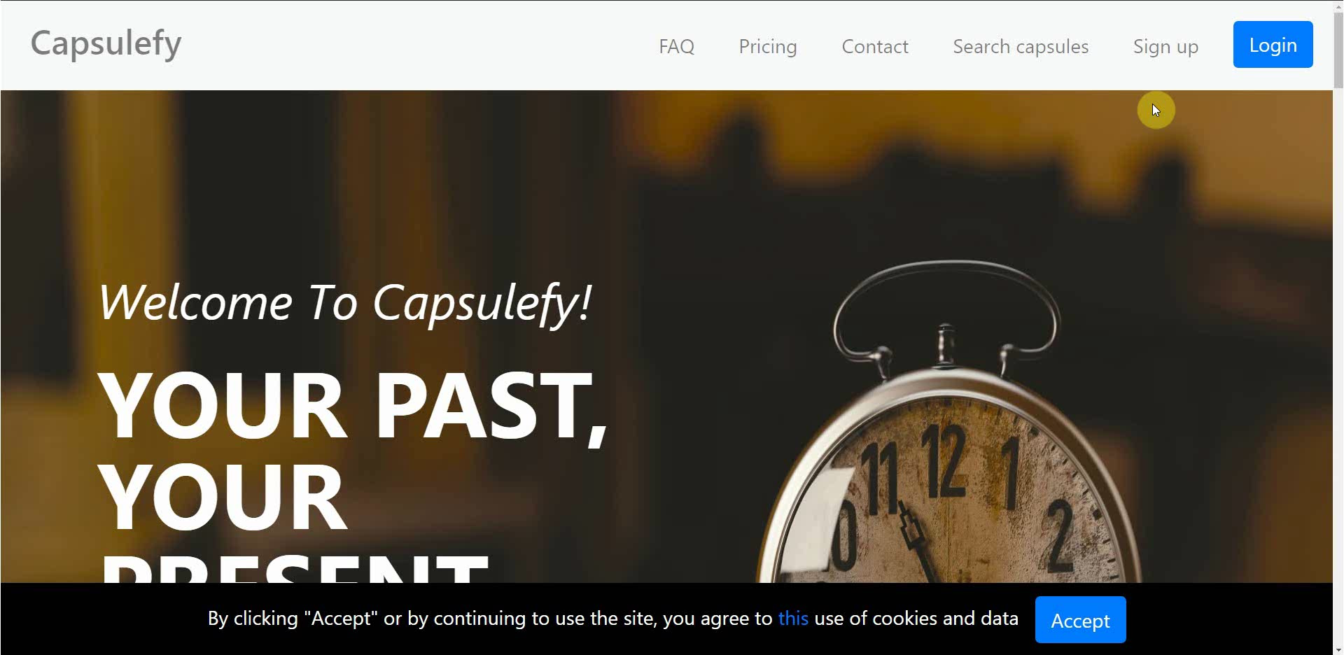
No logged user – Sign up

Slide 10
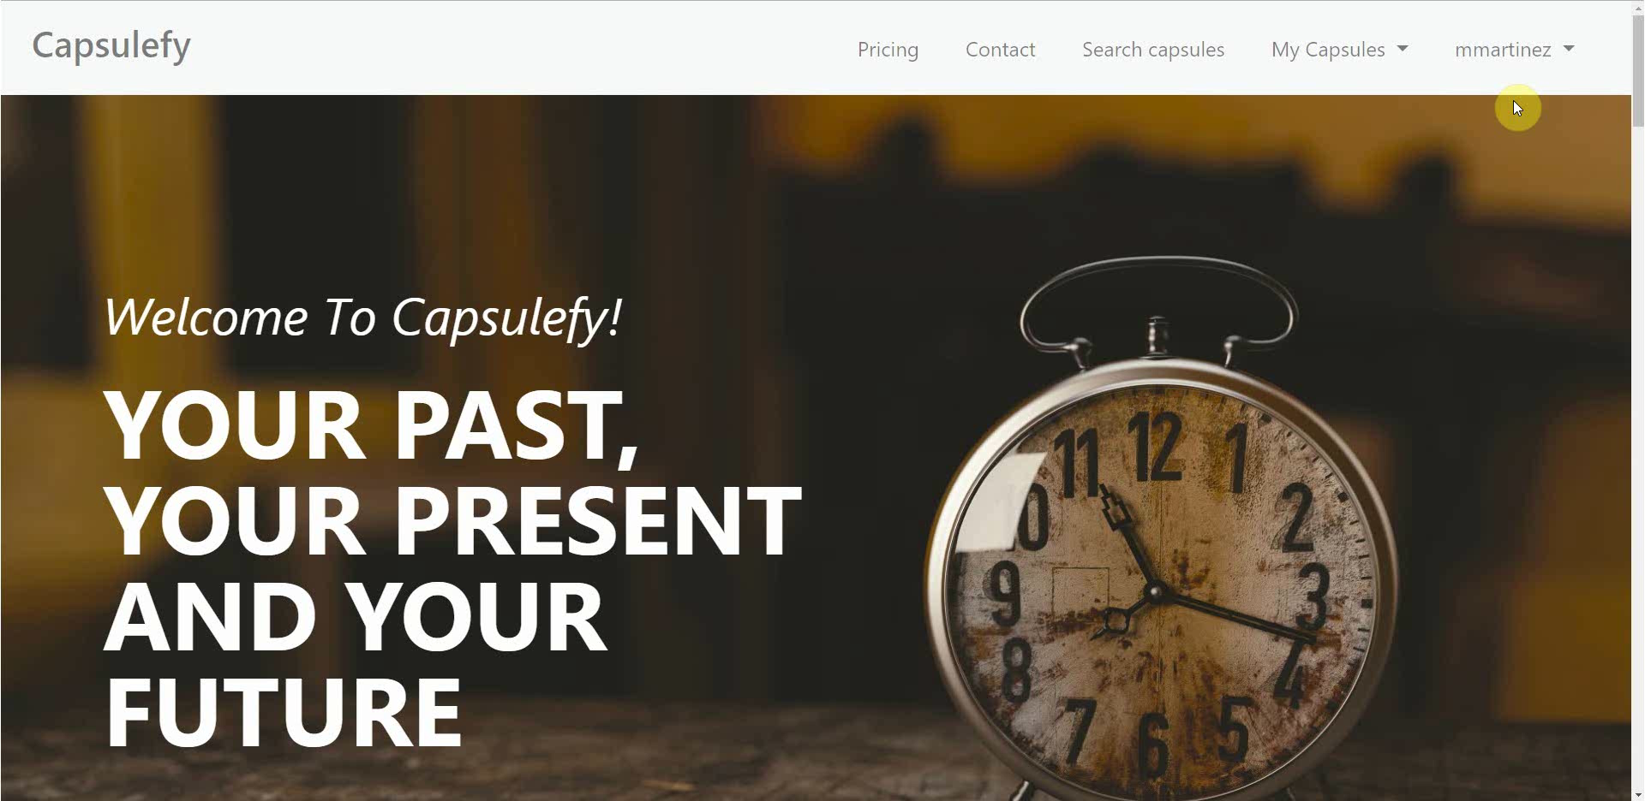
Logged-in user – Connect to Twitter

Slide 11
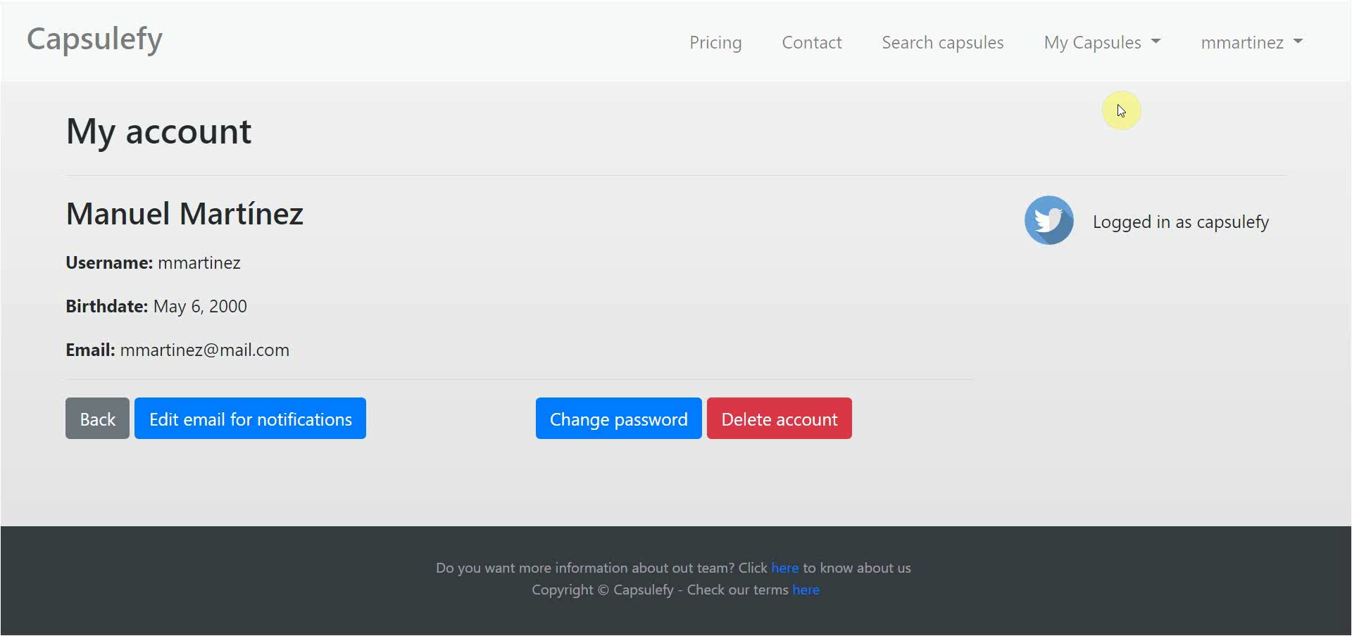
Logged-in user – Create capsule

Slide 12
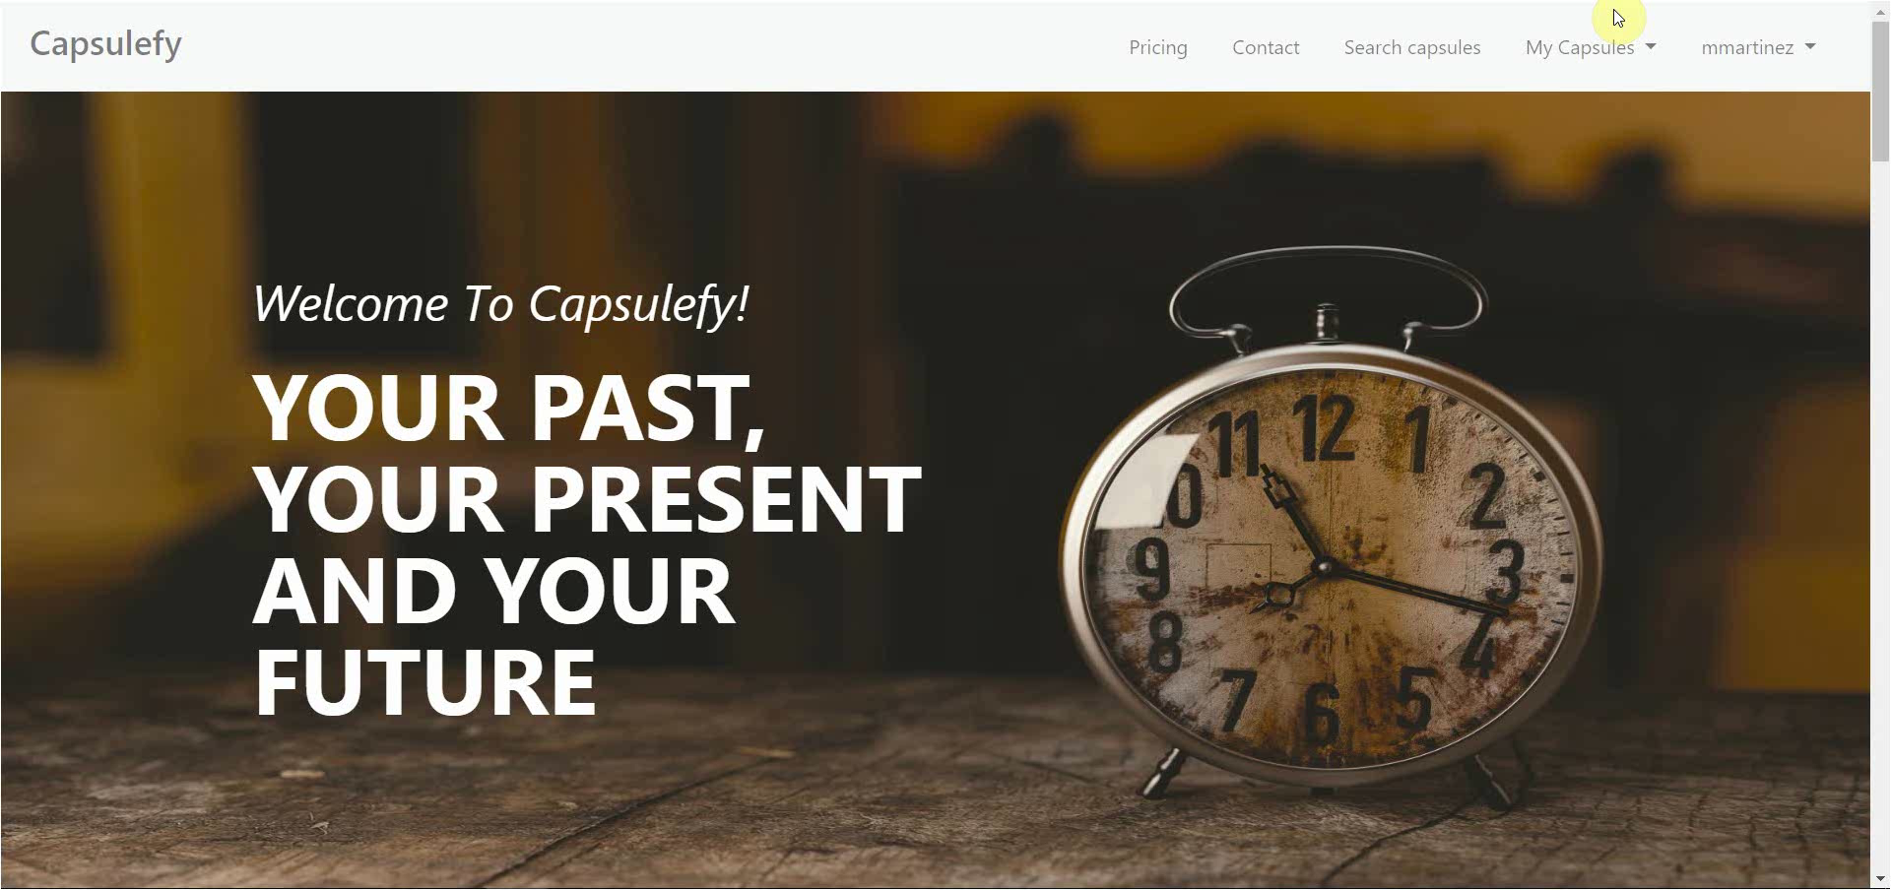
Logged-in user – Refresh timer

Slide 13
TEAM
Who is behind?

Slide 14
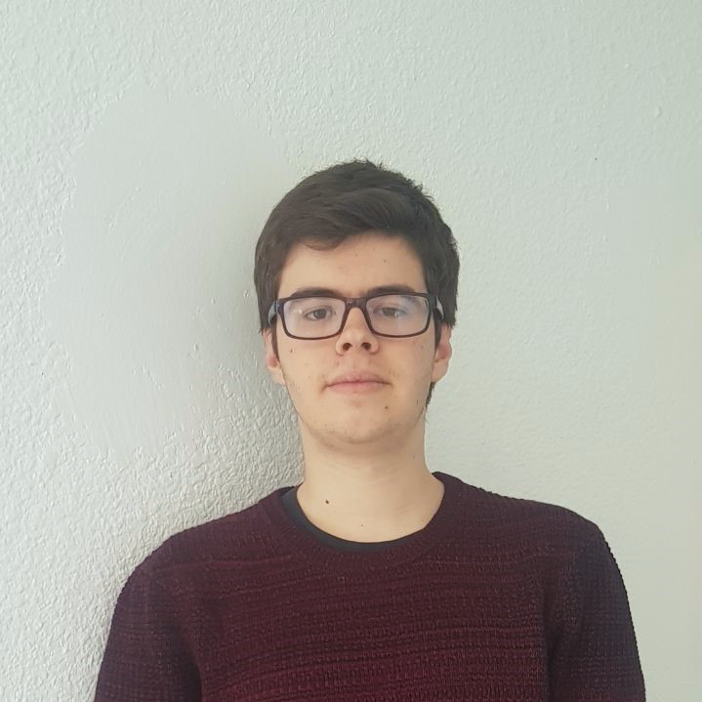






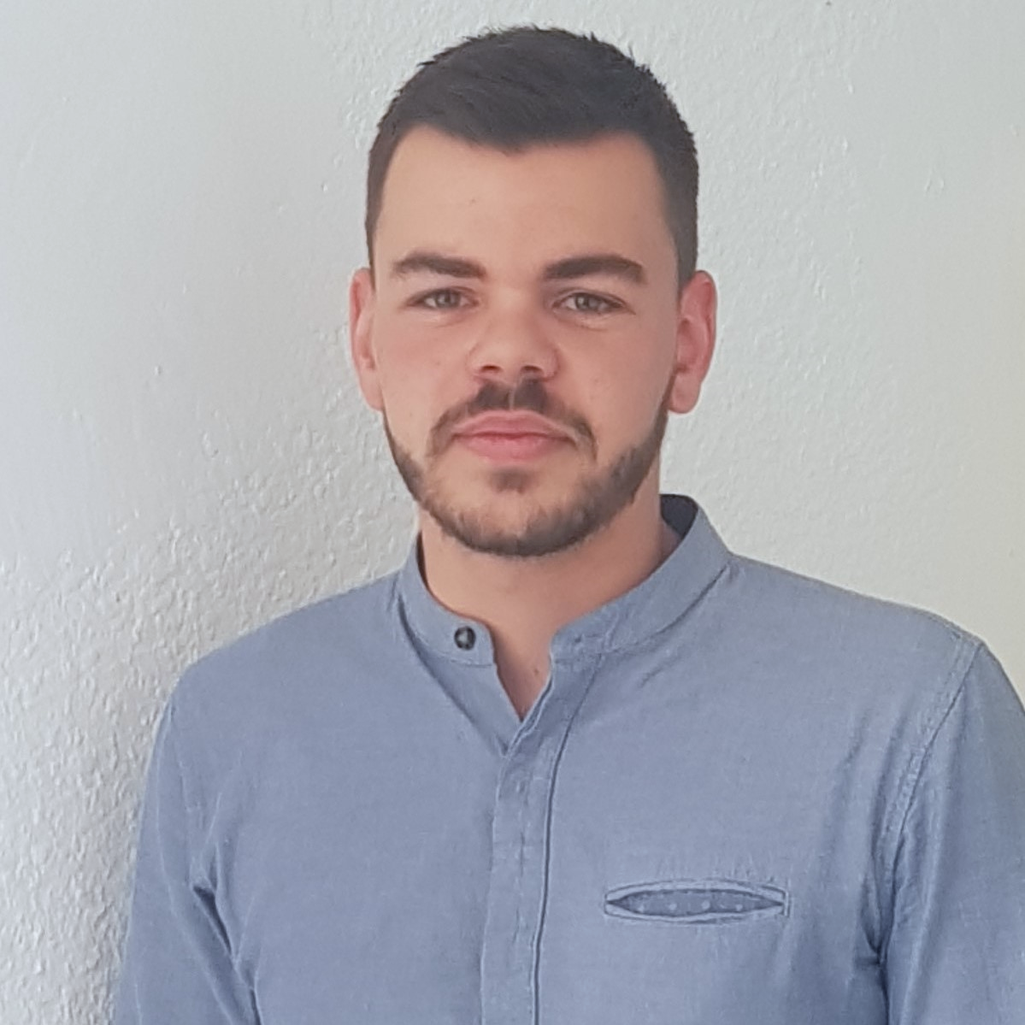



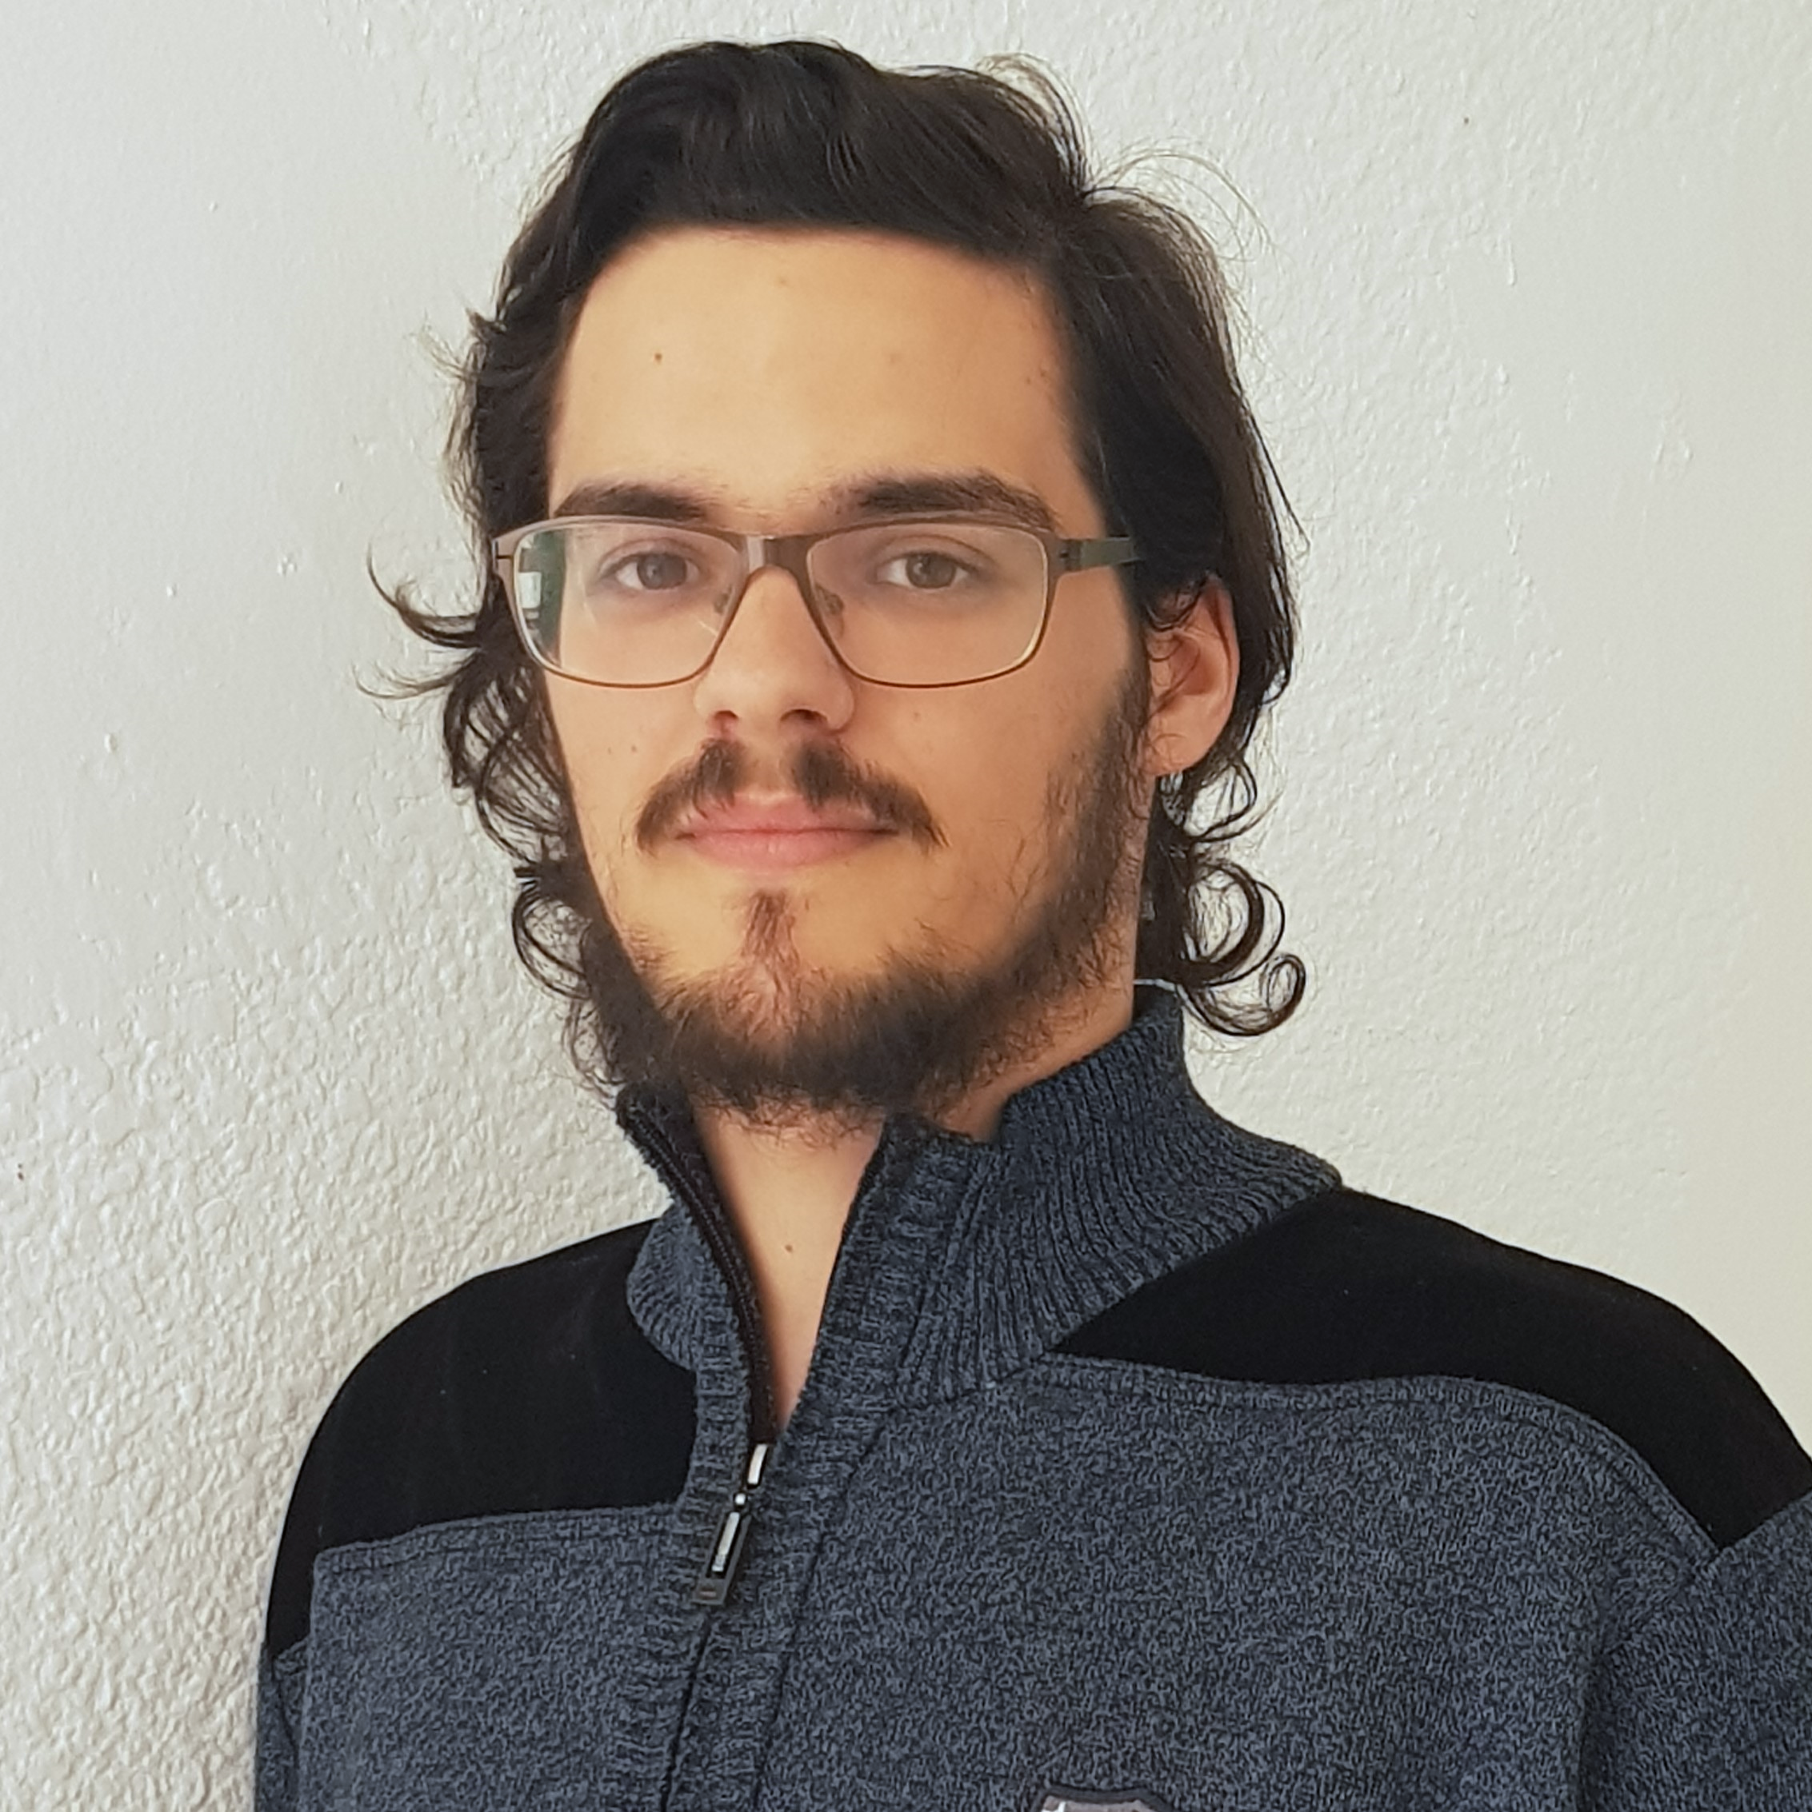



Pablo Rebollo
Project manager, backend developer
Juan Rodríguez
Requirements engineer, backend developer
Adrián Cantón
Business manager, full-stack developer
Rafael Fresno
Backend developer, API integration
Daniel Carpio
Analist,
frontend developer

Slide 15
Try it now!

Slide 16
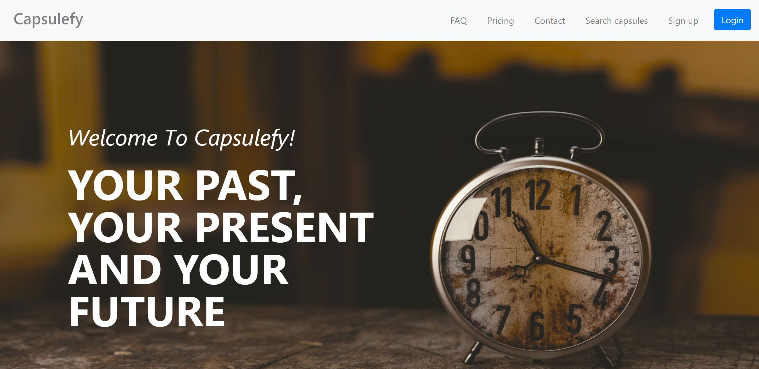
https://capsulefy.herokuapp.com

Slide 17
Thanks!
https://capsulefy.herokuapp.com
Landing page: https://capsulefy01.herokuapp.com
Contact email: capsulefy.communications@gmail.com
GitHub releases: https://github.com/pabreblob/capsulefy/releases

Slide 18

GDPR
How do we comply with GDPR?

Slide 19


Users may delete their profile or capsules

Slide 20


Users can send an email to request unauthorized data deletion

Slide 21

Users will be prompted to reset their password if suspicious activity is detected

Slide 22


Users can send an email to retrieve all their stored data

Slide 23

All this information, including cookie usage, is available on our website

Slide 24


Users must agree to our terms of service before registering

Slide 25
Project launch Week 1
May 13th – May 19th

Slide 26
 |  | May
Task | Assignees | 13 | 14 | 15 | 16 | 17 | 18 | 19
Initial meeting | All
Social media accounts | Juan
Target groups | Pablo
StartUS tasks | Adrián
Advertisement spot | Daniel
Social media marketing | Juan
Marketing strategy | Pablo
Update landing page | Daniel

Slide 27
 |  | May
Task | Assignees | 13 | 14 | 15 | 16 | 17 | 18 | 19
Remake demo videos | Adrián
Update costs | Pablo
Carry out SM marketing | Juan
Review populate | Pablo
Presentation | Rafael
Rehearsal | Pablo

Slide 28
Project launch Week 2
May 20th – May 24th

Slide 29
 |  | May
Task | Assignees | 20 | 21 | 22 | 23 | 24 | 25 | 26
Feedback meeting | All
User ad spot | Adrián
SM marketing | Juan
Investor ad spot | Juan
Future improvements | Daniel
Marketing costs | Pablo
Deploy app | Adrián, Daniel

Slide 30
 |  | May
Task | Assignees | 20 | 21 | 22 | 23 | 24 | 25 | 26
Update landing page | Daniel
Presentation | Rafael
Project launch doc | Pablo
Rehearsal | Pablo

Slide 31
Target users
Who would use Capsulefy?

Slide 32





Target groups
Social media users
Families
People with income
Any gender

Slide 33




Our main user
Man or woman
Married
(or plans to be)
Strong family relationships
With kids
(or plans to have)

Slide 34



Why not elder people?
May be more attached to their family, but…
Less tech savvy

Slide 35




Why not younger people?
May be more familiar with technology, but…
Not much money and long term thinking

Slide 36
Marketing campaign
How are we advertising Capsulefy?

Slide 37




Social networks
Twitter
Facebook
Instagram
YouTube
LinkedIn
@capsulefy
Capsulefy Comms
Capsulefy Project

Slide 38
Social networks
Two adversisement spots available on YouTube
22nd May: first Twitter and Facebook publications (videos and text)
26th and 30th May, 3rd and 7th June: other publications (images, discounts…)

Slide 39

Monthly advertising costs
220 €
140 €
150 €

Slide 40
Refinements
- People living in Spain
- Business category: ‘Cloud storage’
- Keywords: ‘Cápsulas del tiempo online’,
‘Cápsula del tiempo’, ‘Testamento digital’
220 €
Potential audience: 37611 people/month

Slide 41
Estimated performance
1746 – 2935 views/month
137 – 229 clicks/month
Each visit costs 1.2 €
220 €

Slide 42
Refinements
- People between 30 and 50 years
- Parents and married
- Interested in family
- Recently had a baby
- Interested in friendship
- Travel frequently
140 €

Slide 43
Estimated performance
6900 views/month
200 clicks/month
Each visit costs 1.4 €
140 €

Slide 44
Refinements
- People between 25 and 49 years
- Interested in:
· Travels with kids
· Luxury travels
· Fathers/mothers
· Parents of kids
· Upbringing of
teenagers
· Holiday
150 €

Slide 45
Potential audience size
600k people
Daily bidding: 5 €
150 €

Slide 46


Is this effective?
510 €/month * 6 months = 3060 €
9.5 €/sale
10% conversion rate
530 users
530

Slide 47
Discount campaigns
How are we promoting Capsulefy?

Slide 48



Discount campaigns
Free premium capsules during first week
20% discount during first month (8.99 €)
Referral system (during special dates)
%

Slide 49
Current costs
How are we managing costs?

Slide 50
Project duration | 12 weeks
Salaries | 13,390 €
Equipment | 325 €
Hosting, advertising and support | 18,729 €
Risk prevention | 10% (2,724 €)
Total | 35,168 €
Project completion | 95%
Spent budget | 78%
Total deviation | -7650 €

Slide 51
PILOTING PLAN
How are users testing Capsulefy?

Slide 52
Committed users
Name | Age
Francisco R. | 55
Javier A. | 19
Valentin A. | 19
Antonio G. | 26
José Manuel J. | 21
Name | Age
Sandra C. | 28
José Manuel C. | 21
Rafael C. | 55
Antonio C. | 54
Auxiliadora L. | 50

Slide 53
After development
Users receive and fill form
May 4 – May 12
Receive users feedback
May 12
Planification
May 13

Slide 54
Final FEEDBACK RESULTS
What did users say?

Slide 55

“It would be nice to be able to log in with Facebook”

Slide 56
“You could create some familiar plans or promotions”

Slide 57
“I miss some payment options other than PayPal”

Slide 58
“The deadman timer could even be used for your own reminders”

Slide 59
“The interface is nice and clear. I did not experience any problem”

Slide 60
Future improvements
How will we improve Capsulefy in the future?

Slide 61


More admin control
Display more indicators
Ability to change price
To modify some parameters
In the admin dashboard
During temporal promotions

Slide 62


Promotional codes
More payment options
Integrate with other services
To attract new clients
Such as credit card
Like Facebook and Instagram

Slide 63
Promotional codes
More payment options
Integrate with other services
To attract new clients
Such as credit card
Like Facebook and Instagram

Slide 64
Devising a business plan
May 27th – June 2nd

Slide 65
 |  | May |  |  |  |  | June
Task | Assignees | 27 | 28 | 29 | 30 | 31 | 1 | 2
Initial meeting | All
Study pricing | Pablo
Improve SWOT | Juan
Improve ROI | Daniel
Contingency plans | Adrián
Short/long term plans | Daniel, Juan
Presentation | Rafael
Rehearsal | Pablo

Slide 66
Thanks!
Upstream: https://capsulefy.herokuapp.com
Project launch: https://capsulefy05.herokuapp.com
Landing page: https://capsulefy01.herokuapp.com
Contact email: capsulefy.communications@gmail.com
GitHub releases: https://github.com/pabreblob/capsulefy/releases

Slide 67


Deadman switch
ON

Slide 68
TECHNOLOGIES
What stack do we use?

Slide 69


Web app
Users and capsules
Media storage
Social network

Slide 70
COSTS
How much does Capsulefy cost?

Slide 71
Project duration | 4 months
Salaries | 20.80 €/hour
Hours per month | 40
Equipment | 306 €
Hosting, advertising and support | 18,729 €
Risk prevention | 10% (2,724 €)
Total | 44,968 €

Slide 72




Teamwork
Skills
Profitable work
Positive feedback

Slide 73

Realistic | 44968 – 46330 €
Optimistic | 43061 €
Pesimistic | 49054 €
Project duration: 4 months

Slide 74




Risk | Mitigation
Broken computer | Risk prevention funds
Changing terms of use | Monitor
Servers down | Monitor
Incompatible timetables | Reschedule

Slide 75
Year 1: 2000 sales
Balance: -25168 €
Year 2: 4000 sales
Balance: 11441 €
44968 €
39600 €
28159 €
19800 €
Costs
Earnings
Costs
Earnings

Slide 76
Year 3: 8000 sales
Balance: 36450 €
79200 €
29023 €
Costs
Earnings

Slide 77

What do we store?
Users:
- Full name
- Email
- Birthdate
- Notification email
- Social network token
Capsules:
- Content
- Files
- Emails
- Payment ID

Slide 78
Create manual
Create test suite
Test the system
Gather feedback
Fill form

Slide 79
Sprint 2
Users receive and fill form
March 30 – April 6
Development
April 8 – April 12
Receive users feedback
April 6
Planification
April 8

Slide 80
Sprint 3
Easter Week
Users receive and fill form
April 12 – April 22
Development
April 22 – May 3
Receive users feedback
April 22
Planification
April 22

Slide 81

GDPR and measure calculation costs are included in the corresponding members’ salaries

